Slide 1

Time-Dependent Cross-Network Recommender systems
Dilruk Perera and Roger Zimmermann

Slide 2







Motivation
  Multimedia content dominates today's Web information
    400 hours of videos uploaded per minute !
    270,000 snapchat stories are created per minute !
Problem: Information overload
Solution: Recommender Systems (RS)
  Develop user profiles and capture user interests
75% of interactions are based on a recommendation
35% of sales are initiated by a recommendation

Slide 3
Motivation
However: Two major issues co-exist in RS:
  Incomplete user profiles
  Dynamic nature of user preferences

Slide 4







Incomplete user profiles
RS require user profiles to have adequate information
However,
  Existing users : Data sparsity issues
  New users : Cold start problem
Results: Low recommender accuracy
Better approach: Use cross-network information
Items
1
0
0
0
1
0
Items
0
0
0
0
0
0

Slide 5
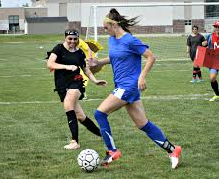



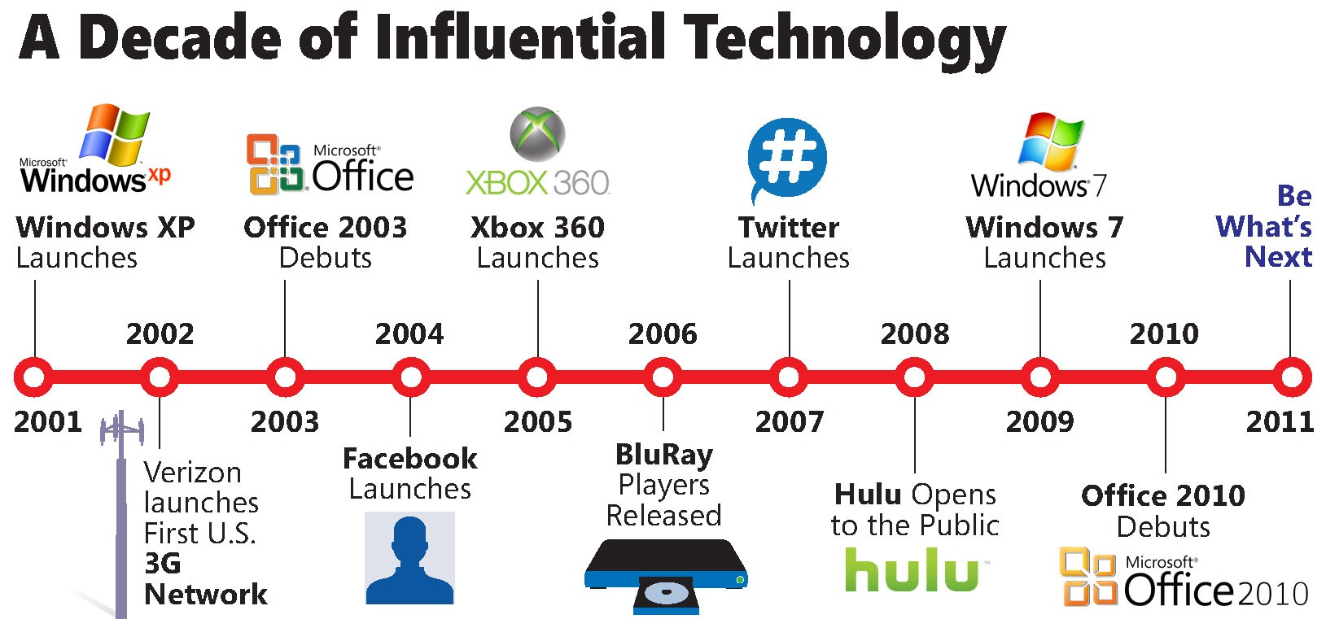

Dynamic nature of user preferences
User preferences change over time
  User tastes/behavior
  New items
  Item popularity changes
Results: Declining recommender accuracy over time

Slide 6
Motivation
Both issues co-exist in a typical RS
  Limits the achievable recommender quality
How to handle both issues effectively in a consolidated solution?

Slide 7

Our solution
We propose :
  Hybrid (Content based + Collaborative Filtering based)
  Time aware
  Cross-network, recommender solution
Illustrated using Twitter auxiliary information for YouTube video recommendations
Source network
Target network

Slide 8





Challenges
Transfer and integrate heterogeneous information from different networks
Uniformly integrate user preferences from different networks (account for network-level factors e.g., network biases)
$$1, 2, …, 12$$
$$Months$$
$$1, 2, …, 12$$
$$Months$$
60
60

Slide 9
Dataset
Created a new cross-network dataset with timestamp information using two existing datasets^{[8, 9]}
Dataset Statistics
Users | 14,133
Tweets | 12,148,994
Video interactions | 254,659
Sparcity | 99.67%
Span | March 2015 to February 2016 (12 months)

Slide 10
Feasibility
  Q1) Is Twitter a good auxiliary information source for YouTube recommendations?
    Users express 26% of their YouTube preferences in Twitter
    For 80% of them, the value increases to 43%
  Q2) Do YouTube users change their preferences within the examined time frame?
    The average intersection for a user in consecutive intervals is 12% only

Slide 11
Approach

Slide 12

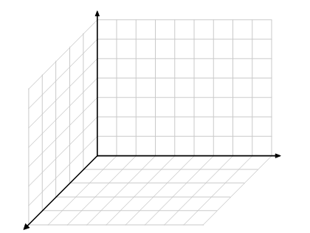






















Tweets
$$t_{1}$$
Topic modeling + Twitter level normalization
$$t_{2}$$
$$. . .$$
$$f$$
$$t_{n}$$
$$t_{3}$$
$$t_{1}$$
$$t_{2}$$
$$t_{t}$$
$$t_{3}$$
$$t_{n}$$
$$t_{1}$$
$$T$$
$$t_{t}$$
$$t_{n}$$
$$t_{2}$$
$$t_{1}$$
$$K^{t}$$
Homogeneous cross-network topical space
$$t_{2}$$
Topic modeling + YouTube level normalization
$$. . .$$
$$t_{n}$$
Videos

Slide 13


























$$f$$
$$t_{2}$$
$$t_{1}$$
$$t_{t}$$
$$t_{2}$$
$$t_{3}$$
$$t_{n}$$
$$t_{3}$$
$$t_{n}$$
$$t_{1}$$
$$t_{t}$$
$$t_{2}$$
$$t_{3}$$
$$t_{t}$$
$$T$$
$$t_{1}$$
$$t_{n}$$
$$t_{1}$$
$$t_{n}$$
$$t_{3}$$
$$t_{t}$$
$$t_{2}$$
$$K^{t}$$
Homogeneous cross-network topical space

Slide 14
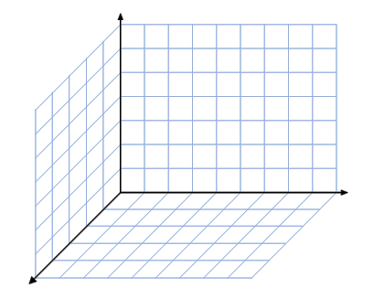













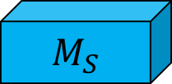















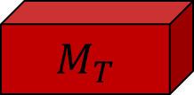





Cross-network topical space
Transfer function
$$f$$
$$t_{1}$$
$$t_{2}$$
$$t_{3}$$
$$t_{t}$$
$$t_{n}$$
$$M_{T}$$
$$t_{1}$$
$$t_{2}$$
$$t_{3}$$
$$t_{t}$$
$$t_{n}$$
$$f$$
$$t_{3}$$
$$t_{n}$$
$$t_{2}$$
$$T$$
$$t_{1}$$
$$t_{t}$$
$$K^{t}$$
$$t_{3}$$
$$t_{n}$$
$$t_{2}$$
$$t_{1}$$
$$t_{1}$$
$$t_{t}$$
$$t_{t}$$
$$t_{3}$$
$$t_{2}$$
$$M_{S}$$
$$t_{3}$$
$$t_{t}$$
$$T$$
$$t_{n}$$
$$t_{2}$$
$$t_{n}$$
Transfer function
$$t_{1}$$
$$K$$
YouTube latent space

Slide 15


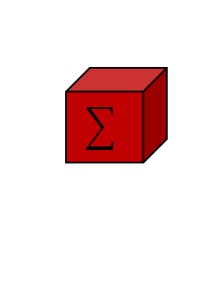














$$f$$
$$t_{1}$$
$$t_{t}$$
$$t_{2}$$
$$t_{3}$$
$$t_{3}$$
$$t_{t}$$
$$t_{n}$$
$$T$$
$$t_{1}$$
$$t_{2}$$
$$t_{n}$$
$$f$$
$$K$$
YouTube latent space
$$t_{3}$$
$$t_{t}$$
$$t_{2}$$
$$T$$
$$t_{n}$$
$$t_{1}$$
$$K$$
YouTube latent space

Slide 16
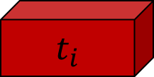











$$f$$
Time aware integration function
$$t_{2}$$
$$t_{3}$$
$$t_{t}$$
$$t_{1}$$
$$t_{n}$$
$$t_{i}$$
$$t_{2}$$
$$t_{3}$$
$$t_{t}$$
$$t_{n}$$
$$T$$
$$t_{1}$$
$$K$$
$$f$$
YouTube latent space
$$t_{n+1}$$
$$T$$
$$K$$
YouTube latent space

Slide 17
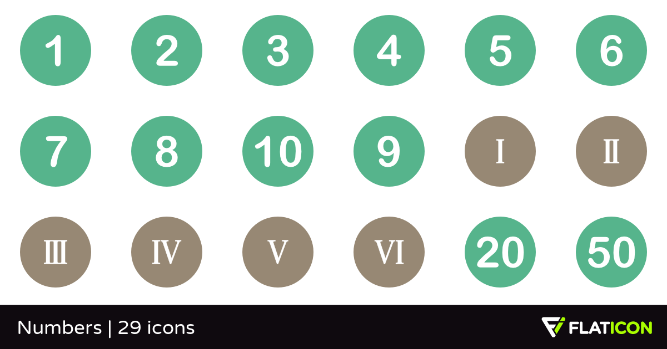



















Process : Overview
Cross-network topical space
$$t_{1}$$
$$f$$
$$t_{2}$$
TM + Normalization
$$. . .$$
$$. . .$$
TM + Normalization
$$t_{n}$$
$$T$$
$$M_{S}, M_{T}{, t}_{i}$$
$$K^{t}$$
$$M_{T}$$
$$M_{S}$$
$$f$$
$$f$$
$$f$$
$$t_{n+1}$$
$$t_{2}$$
$$t_{3}$$
$$t_{t}$$
$$t_{i}$$
$$t_{n}$$
$$T$$
$$T$$
$$t_{1}$$
$$T$$
$$K$$
$$K$$
$$K$$
YouTube latent space

Slide 18
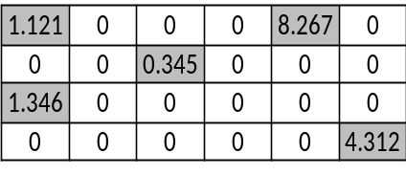

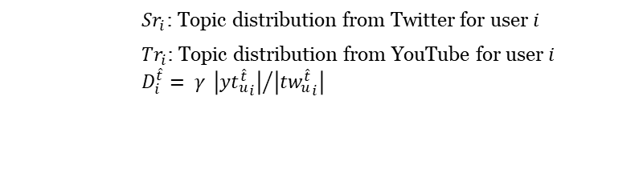



Optimization
$$R^{t}$$
Users
Items
Stochastic Gradient Descent (SGD)
$$U^{T}$$
$$V$$
$$L= \min_{t_{∗}, { M}_{S},{ M}_{T}, v_{∗}}{\sum_{(i, j) ∈ ℰ}{{\left(r_{i,j}^{t}−t_{i} \left({Sr}_{i}∙M_{S}+D_{i}∙{Tr}_{i} ∙M_{T}\right) v_{j}\right)}^{2}} }$$
$$+ λ \left({\left\|t_{i}\right\|}^{2}+ {\left\|M_{S}\right\|}^{2}+ {\left\|M_{T}\right\|}^{2}+ {\left\|v_{j}\right\|}^{2}\right)$$
      ${Sr}_{i}$: Topic distribution from Twitter for user $i$
      ${Tr}_{i}$: Topic distribution from YouTube for user $i$
      $$D_{i}^{\hat{t}}= γ {\left|{{yt}_{u}^{\hat{t}}}_{i}\right|}/{\left|{{tw}_{u}^{\hat{t}}}_{i}\right|}$$

Slide 19
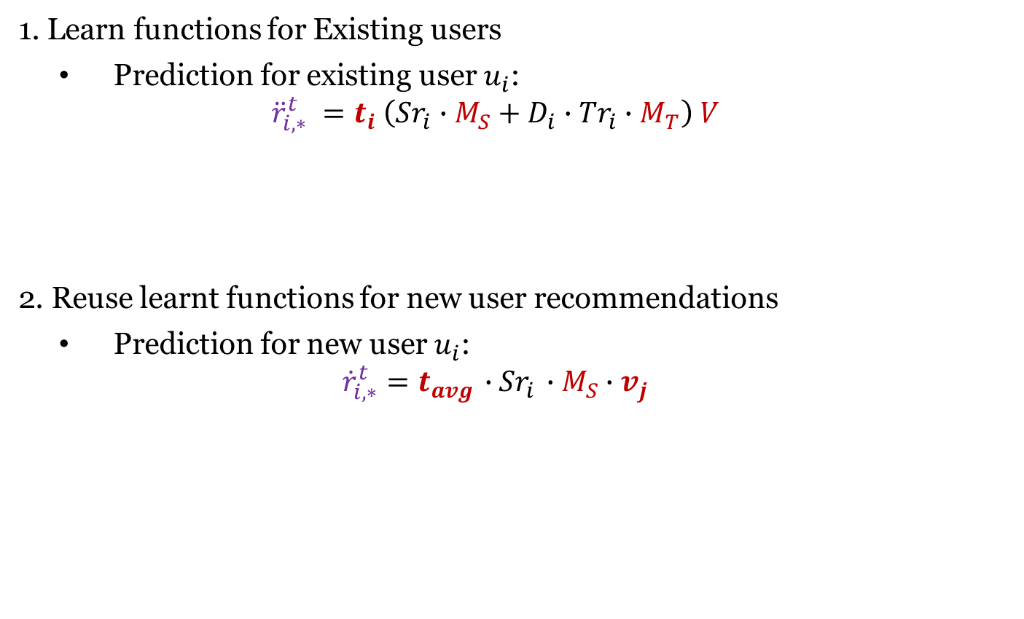
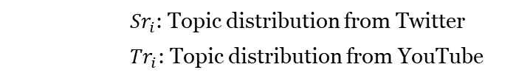
Training process
1. Learn functions for Existing users
  Prediction for existing user $u_{i}$:
  $${\ddot{r}}_{i,∗}^{t} =t_{i} \left({Sr}_{i}∙M_{S}+D_{i}∙{Tr}_{i}∙M_{T}\right) V$$
2. Reuse learnt functions for new user recommendations
  Prediction for new user $u_{i}$:
  $${\dot{r}}_{i,∗}^{t}=t_{avg}{ ∙Sr}_{i} ∙M_{S}∙v_{j}$$
      ${Sr}_{i}$: Topic distribution from Twitter
      ${Tr}_{i}$: Topic distribution from YouTube

Slide 20
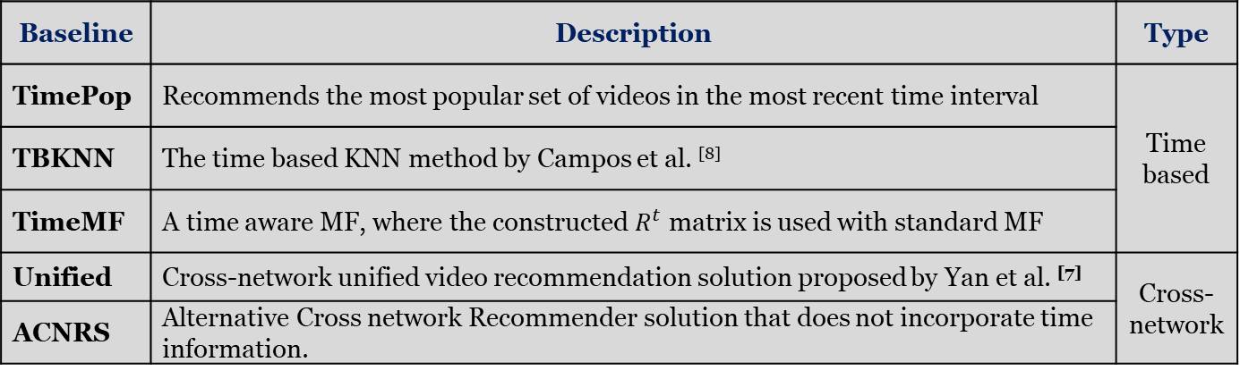
Experiments
  Dataset configurations:
  Baseline methods:
Granularity | Experiments | Training set | Testing set
Biweekly intervals | Exp. 1 | First 40 weeks (83%) | Last 8 weeks (17%)
 | Exp. 2 | First 44 weeks (92%) | Last 4 weeks (8%)
Monthly intervals | Exp. 3 | First 10 months (83%) | Last 2 months (17%)
 | Exp. 4 | First 11 months (92%) | Last 1 month (8%)
Baseline | Description | Type
TimePop | Recommends the most popular set of videos in the most recent time interval | Time based
TBKNN | The time based KNN method by Campos et al. ^{[8]}
TimeMF | A time aware MF, where the constructed $R^{t}$ matrix is used with standard MF
Unified | Cross-network unified video recommendation solution proposed by Yan et al. ^{[7]} | Cross-network
ACNRS | Alternative Cross network Recommender solution that does not incorporate time information.

Slide 21
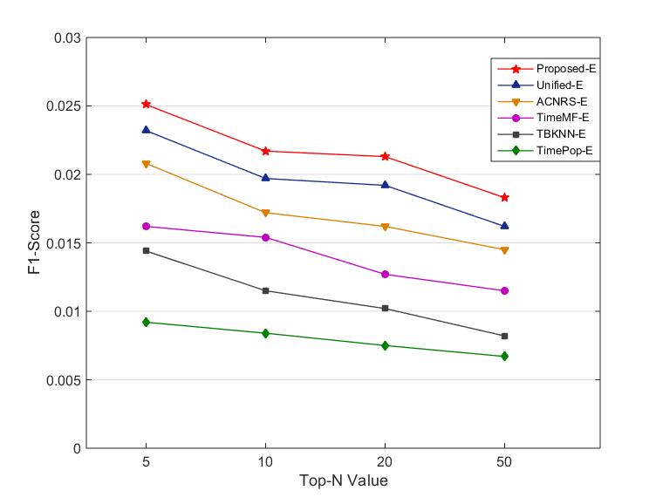
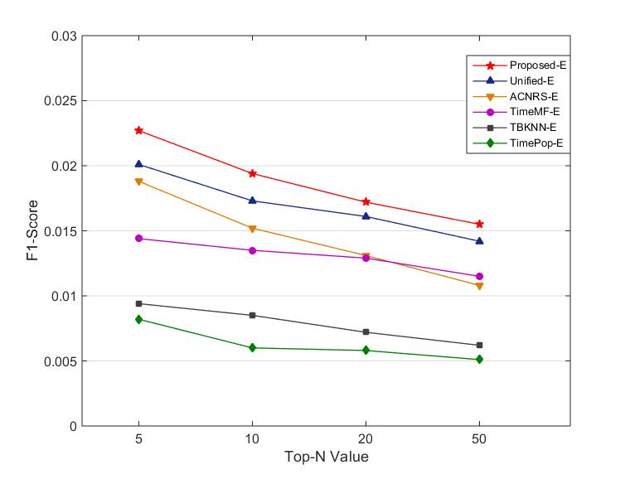
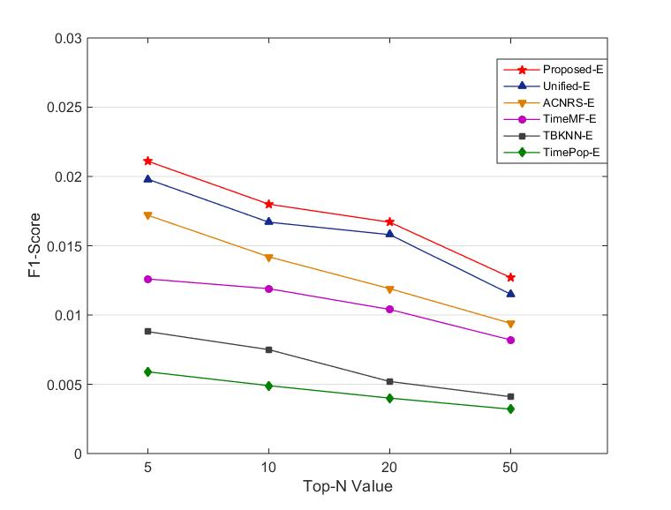
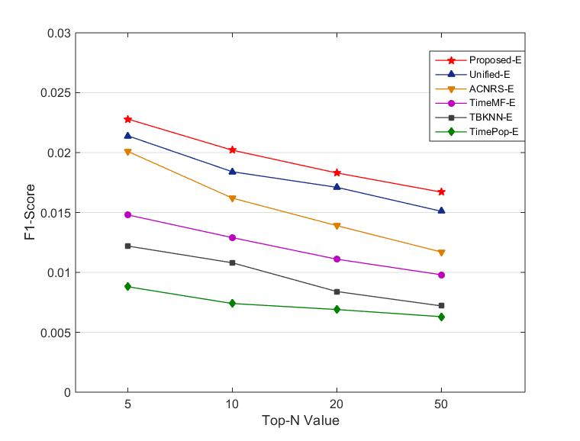
Exp. 1
Exp. 2
Exp. 3
Exp. 4

Slide 22
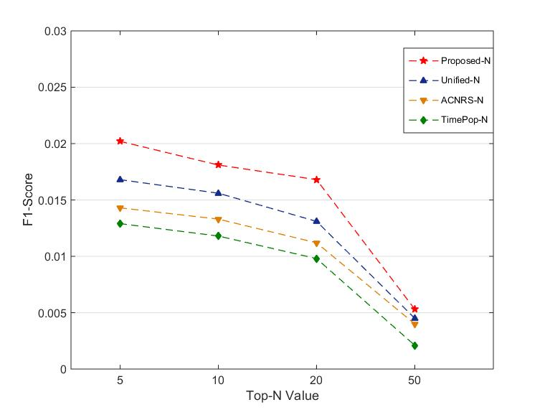
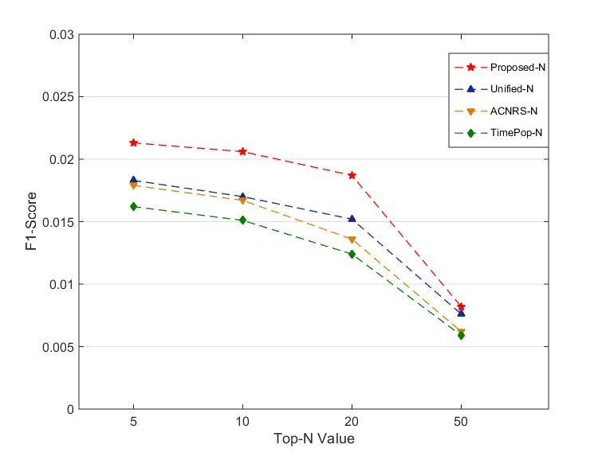
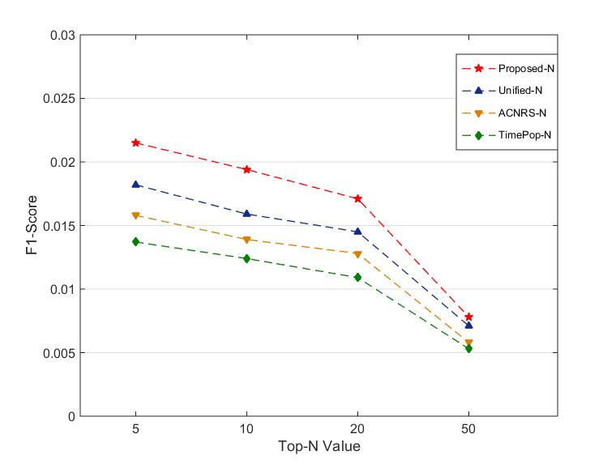
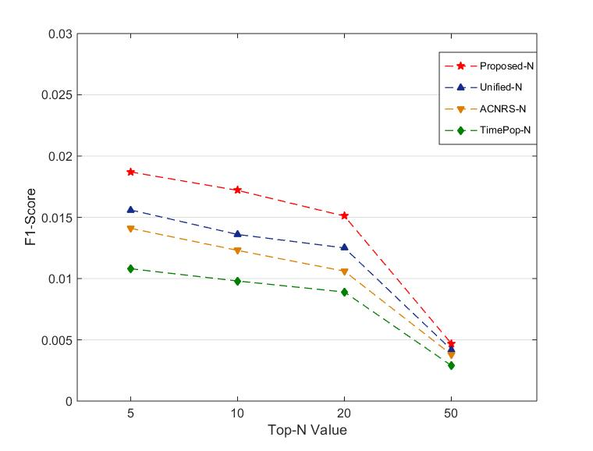
Exp. 1
Exp. 2
Exp. 3
Exp. 4

Slide 23
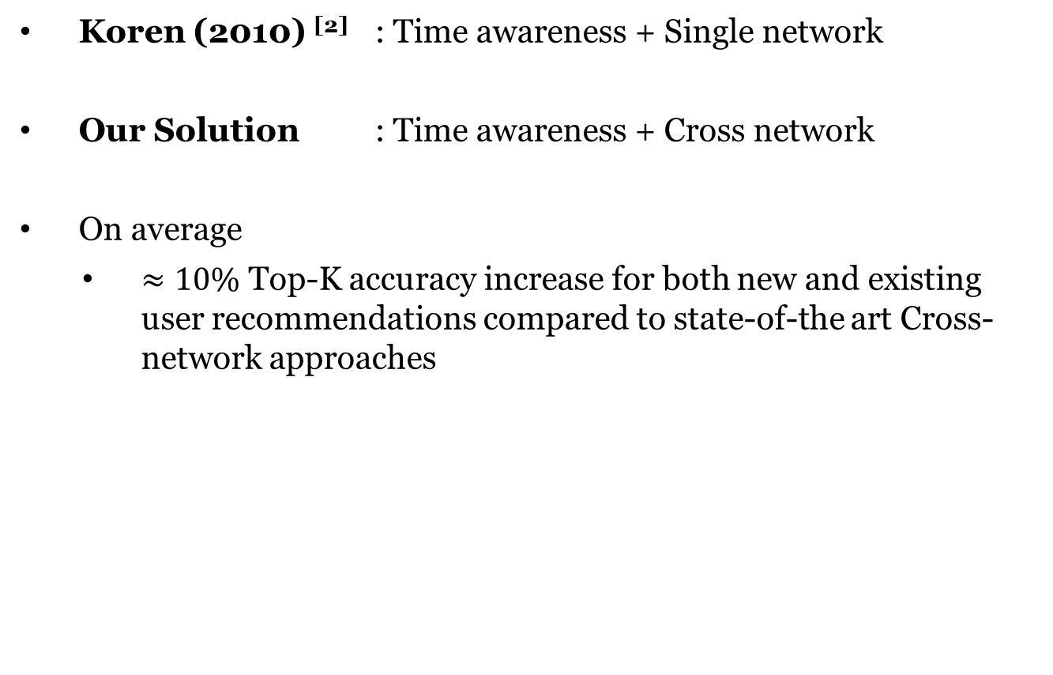
Conclusion
Koren (2010) ^{[2]} : Time awareness + Single network
Our Solution : Time awareness + Cross network
On average
  $≈10\%$ Top-K accuracy increase for both new and existing user recommendations compared to state-of-the art Cross-network approaches

Slide 24
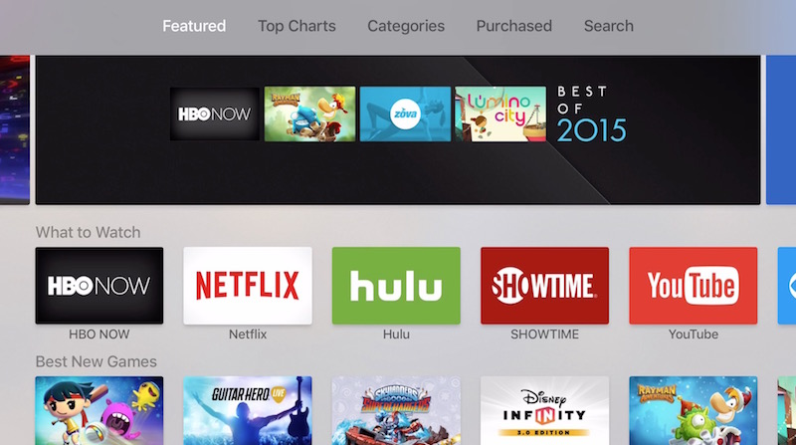
Impact
Novelty and diversity of Recommendations
Develop one stop recommender platforms
 | TimePop | TimeMF | Unified | Proposed
Diversity | 0.6823 | 0.6686 | 0.7265 | 0.7423
Novelty | 0.0159 | 0.0151 | 0.0187 | 0.0209

Slide 25

Thank You
Perera, Dilruk, and Roger Zimmermann. "Exploring the use of Time-Dependent Cross-Network Information for Personalized Recommendations." Proceedings of the 2017 ACM on Multimedia Conference. ACM, 2017.

Slide 26
References
[1] Cui, P., Wang, Z. and Su, Z., 2014, November. What videos are similar with you?: Learning a common attributed representation for video recommendation. In Proceedings of the 22nd ACM international conference on Multimedia (pp. 597-606). ACM.
[2] Koren, Y., 2010. Collaborative filtering with temporal dynamics. Communications of the ACM, 53(4), pp.89-97.
[3] Li, B., Zhu, X., Li, R., Zhang, C., Xue, X. and Wu, X., 2011. Cross-domain collaborative filtering over time. In proceedings of the 22nd international joint conference on artificial intelligence volume three (pp. 2293-2298). AAAI Press.
[4] Sang, J., Deng, Z., Lu, D. and Xu, C., 2015. Cross-OSN User Modeling by Homogeneous Behavior Quantification and Local Social Regularization. IEEE Transactions on Multimedia, 17(12), pp.2259-2270.
[5] Yan, M., Sang, J., Xu, C. and Hossain, M.S., 2016. A Unified Video Recommendation by Cross-Network User Modeling. ACM Transactions on Multimedia Computing, Communications, and Applications (TOMM), 12(4), p.53.
[6] Yan, M., Sang, J. and Xu, C., 2015. Unified YouTube video recommendation via cross-network collaboration. In Proceedings of the 5th ACM on International Conference on Multimedia Retrieval (pp. 19-26). ACM.
[7] Deng, Z., Yan, M., Sang, J. and Xu, C., 2015. Twitter is faster: Personalized time-aware video recommendation from Twitter to YouTube. ACM Transactions on Multimedia Computing, Communications, and Applications (TOMM), 11(2), p.31.
[8] Lim, B.H., Lu, D., Chen, T. and Kan, M.Y., 2015. # mytweet via Instagram: Exploring user behavior across multiple social networks. In 2015 IEEE/ACM International Conference on Advances in Social Networks Analysis and Mining (ASONAM) (pp.113-120). IEEE.
[9] Yan, M., Sang, J. and Xu, C., 2014. Mining cross-network association for YouTube video promotion. In Proceedings of the 22nd ACM international conference on Multimedia (pp. 557-566). ACM.

Slide 27
Appendices

Slide 28
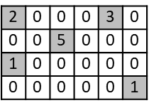
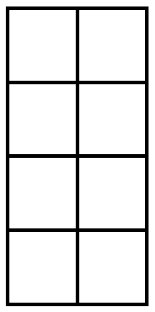
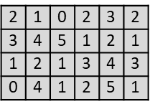
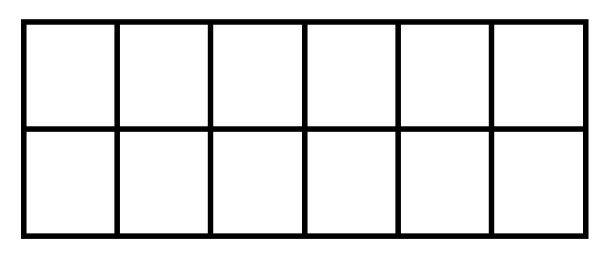











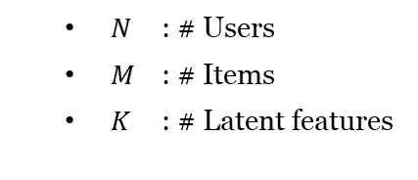
Background: Matrix Factorization (MF)
    Maps users and items to the same latent space for direct comparisons
$$R$$
$$U^{T}$$
$$V$$
$$R′$$
$$N$$
$$≈$$
$$N$$
$$×$$
$$K$$
$$=$$
$$M$$
$$M$$
$$K$$
    $$R^{′} = U^{T} × V ≈ R$$
Stochastic Gradient Descent (SGD)
    $N$ : # Users
    $M$ : # Items
    $K$ : # Latent features
$$K$$

Slide 29




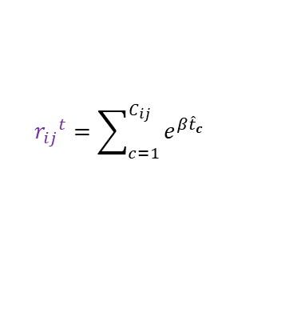


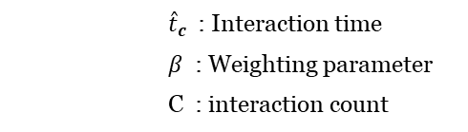

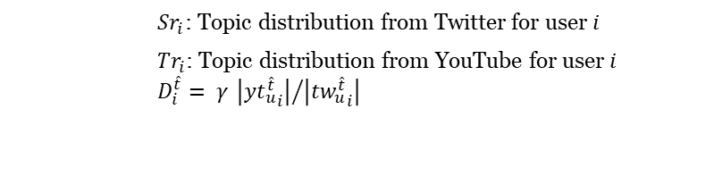







Optimization
Users $(M_{S},M_{T}, t_{i} )$
$$R$$
$$f$$
    $$U^{T} × V ≈ R$$
Items
$$N$$
$${r_{ij}}^{t}=\sum_{c=1}^{C_{ij}}{e^{β{\hat{t}}_{c}}}$$
$$T$$
Stochastic Gradient Descent (SGD)
$$M$$
$$K$$
$$t_{n+1}$$
      ${\hat{t}}_{c}$: Interaction time
      $β$ : Weighting parameter
      C : interaction count
$$R^{t}$$
      ${Sr}_{i}$: Topic distribution from Twitter for user $i$
      ${Tr}_{i}$: Topic distribution from YouTube for user $i$
      $$D_{i}^{\hat{t}}= γ {\left|{{yt}_{u}^{\hat{t}}}_{i}\right|}/{\left|{{tw}_{u}^{\hat{t}}}_{i}\right|}$$
Stochastic Gradient Descent (SGD)
$$U^{T}$$
$$V$$
$$L= \min_{t_{∗}, { M}_{S},{ M}_{T}, v_{∗}}{\sum_{(i, j) ∈ ℰ}{{\left(r_{i,j}^{t}−t_{i} \left({Sr}_{i}∙M_{S}+D_{i}∙{Tr}_{i} ∙M_{T}\right) v_{j}\right)}^{2}} }$$
$$+ λ \left({\left\|t_{i}\right\|}^{2}+ {\left\|M_{S}\right\|}^{2}+ {\left\|M_{T}\right\|}^{2}+ {\left\|v_{j}\right\|}^{2}\right)$$

Slide 30

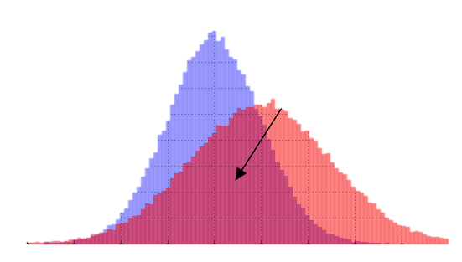









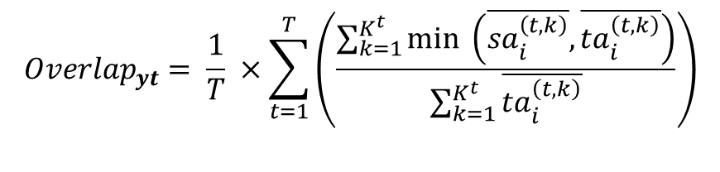
Feasibility (Q1)
Intuition: Check if YouTube users express similar interests in Twitter in the same time interval
Process:
Observations:
  Users express 26% of their YouTube preferences in Twitter
  For 80% of them, the value increases to 43%
$${Sa}_{i}$$
$${Ta}_{i}$$
$$\overline{{sa}_{i}^{t}}$$
$$\overline{{ta}_{i}^{t}}$$
T : # of time intervals
$K^{t}$: # of topics
$$T$$
$$T$$
$$K^{t}$$
$$K^{t}$$
$$K^{t}$$
$$K^{t}$$
$${Overlap}_{yt}= \frac{1}{T} ×\sum_{t=1}^{T}{\left(\frac{\sum_{k=1}^{K^{t}}{min \left(\overline{{sa}_{i}^{\left(t,k\right)}},\overline{{ta}_{i}^{\left(t,k\right)}}\right)}}{\sum_{k=1}^{K^{t}}{\overline{{ta}_{i}^{\left(t,k\right)}}}}\right)}$$

Slide 31





Feasibility (Q2)
Intuition: Check if user preference overlaps in consecutive time intervals are small
Process:
Observation: The average intersection for a user in consecutive intervals: 12%
$${Ta}_{i}$$
$$\overline{{ta}_{i}^{t}}$$
$$T$$
$$\overline{{ta}_{i}^{t+1}}$$
$$K^{t}$$

Slide 32
Literature
Time
unaware
Time
aware
•
Koren (2010) ^{[2]}
Single
Network/
System
Standard recommender
•
Li et al. (2011) ^{[3]}
systems
•
…
•
Sang et al. (2015) ^{[4]}
Cross
Deng et al. (2014) ^{[7]}
-
Network
•
Yan et al. (2015) ^{[6]}
•
…

Slide 33
Exp. 1
 | Proposed-E | Unified-E | TimeMF-E | TimePop-E | Proposed-N | Unified-N | TimePop-N
5 | 0.0227 | 0.0201 | 0.0144 | 0.0082 | 0.0202 | 0.0181 | 0.0053
10 | 0.0194 | 0.0173 | 0.0135 | 0.006 | 0.0168 | 0.0156 | 0.0045
15 | 0.0172 | 0.0161 | 0.0129 | 0.0058 | 0.0143 | 0.0133 | 0.004
20 | 0.0155 | 0.0142 | 0.0122 | 0.0051 | 0.0129 | 0.0118 | 0.0021
Exp. 2
 | Proposed-E | Unified-E | TimeMF-E | TimePop-E | Proposed-N | Unified-N | TimePop-N
5 | 0.0251 | 0.0232 | 0.0162 | 0.0092 | 0.0213 | 0.0206 | 0.0082
10 | 0.0217 | 0.0197 | 0.0154 | 0.0084 | 0.0183 | 0.017 | 0.0076
15 | 0.0213 | 0.0192 | 0.0127 | 0.0075 | 0.0179 | 0.0167 | 0.0062
20 | 0.0183 | 0.0162 | 0.0115 | 0.0067 | 0.0162 | 0.0151 | 0.0059

Slide 34
Exp. 3
 | Proposed-E | Unified-E | TimeMF-E | TimePop-E | Proposed-N | Unified-N | TimePop-N
5 | 0.0211 | 0.0198 | 0.0136 | 0.0059 | 0.0127 | 0.0118 | 0.0047
10 | 0.018 | 0.0167 | 0.0129 | 0.0049 | 0.0122 | 0.0116 | 0.0042
15 | 0.0167 | 0.0158 | 0.0114 | 0.004 | 0.0116 | 0.0103 | 0.0038
20 | 0.0127 | 0.0115 | 0.0098 | 0.0032 | 0.0112 | 0.0102 | 0.0029
Exp. 4
 | Proposed-E | Unified-E | TimeMF-E | TimePop-E | Proposed-N | Unified-N | TimePop-N
5 | 0.0228 | 0.0214 | 0.0158 | 0.0088 | 0.0215 | 0.0194 | 0.0078
10 | 0.0202 | 0.0184 | 0.0149 | 0.0074 | 0.0182 | 0.0159 | 0.0071
15 | 0.0183 | 0.0171 | 0.0121 | 0.0069 | 0.0158 | 0.0139 | 0.0058
20 | 0.0167 | 0.0151 | 0.0109 | 0.0063 | 0.0137 | 0.0124 | 0.0053

Slide 35
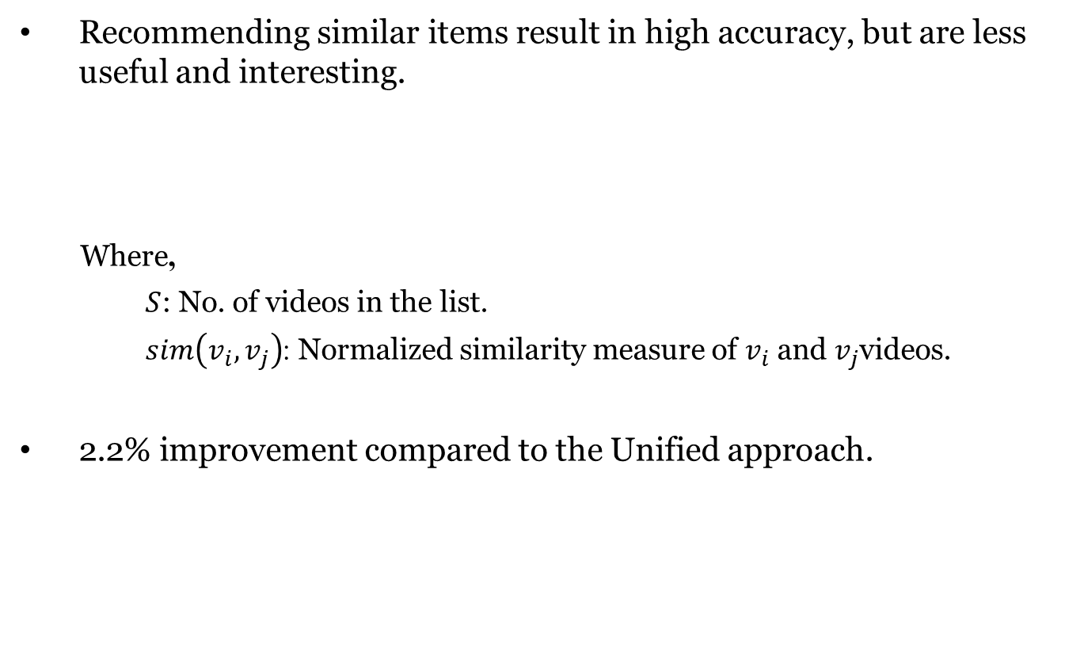
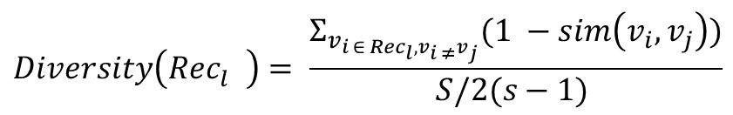
Diversity
Recommending similar items result in high accuracy, but are less useful and interesting.
Where,
      $S$: No. of videos in the list.
$sim\left(v_{i},v_{j}\right)$: Normalized similarity measure of $v_{i}$ and $v_{j}$videos.
2.2% improvement compared to the Unified approach.
$$Diversity\left({Rec}_{l}^{}\right)= \frac{Σ_{v_{i ∈ {Rec}_{l}, v_{i ≠}v_{j}}}(1 −sim\left(v_{i}, v_{j}\right))}{S/2(s−1) }$$
 | TimePop | TimeMF | Unified | Proposed
Diversity | 0.6823 | 0.6686 | 0.7265 | 0.7423

Slide 36
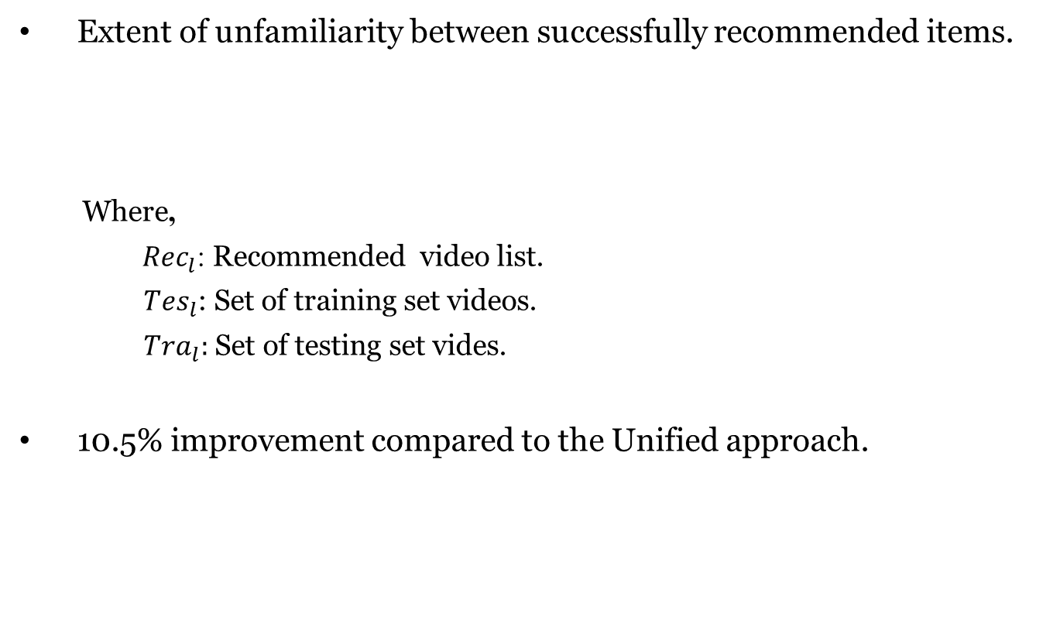
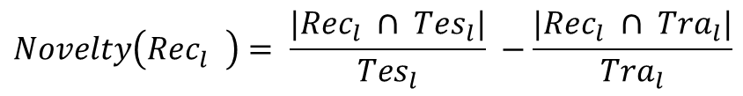
Novelty
Extent of unfamiliarity between successfully recommended items.
Where,
${Rec}_{l}$: Recommended video list.
      ${Tes}_{l}$: Set of training set videos.
      ${Tra}_{l}:$ Set of testing set vides.
10.5% improvement compared to the Unified approach.
$$Novelty\left({Rec}_{l}^{}\right)= \frac{|{Rec}_{l} ∩ {Tes}_{l}|}{{Tes}_{l}} −\frac{|{Rec}_{l} ∩ {Tra}_{l}|}{{Tra}_{l}}$$
 | TimePop | TimeMF | Unified | Proposed
Novelty | 0.0159 | 0.0151 | 0.0187 | 0.0209

